Slide 1
Solve Your Escape
Team HAKR
Aidan Buffum, Hong Hong, and Regina Reynolds

Slide 2
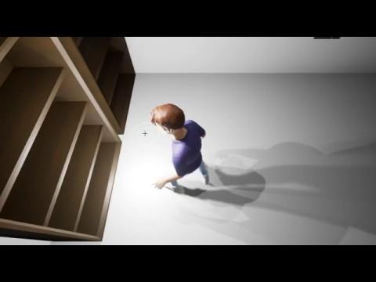
Trailer

Slide 3
The Team
IMGD 4000: Aidan Buffum - Team Leader & Technical Artist Hung Hong
IMGD 4500: Regina Reynolds - Artist

Slide 4
The Game
Escape room style game
Solve various puzzles to progress
Interact with the environment for clues

Slide 5
Technical Features
Dynamic location-based cameras
Progression tracking system
Keypad and item placement puzzles
Interactive Environment
Main and Pause menus

Slide 6
Location-Based Cameras
Fixed-location cameras
Smooth transitions between cameras
Cameras swap dynamically based on player location

Slide 7
Progression tracking system
Player progress is tracked
Determines what is accessible to the player
Some puzzles only solvable when others have been solved
Doors only open after some puzzles solved

Slide 8
Keypad and item placement puzzles
Keypad puzzle tracks and displays which buttons were pushed
When buttons are pressed in the right order, the player progresses
Player can pick up some items and unlocks more of the house based on where the items are placed

Slide 9
Interactive Environment
Player can interact with various non-puzzle props in the environment
Flavor text lets the player learn more about the environment
Hints provide context for solving the puzzles

Slide 10
Main and Pause Menus
Main Menu welcomes the player to the game
Features Play & Quit buttons
Pause Menu lets the player take a break from the game
Features Resume & Quit buttons
Win Menu congratulates the player for winning
Features a congratulatory message & a Quit button

Slide 11
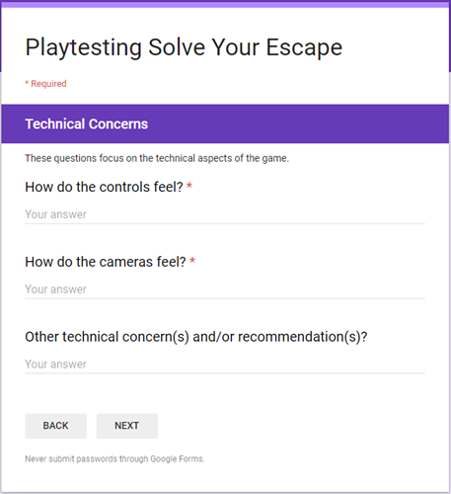
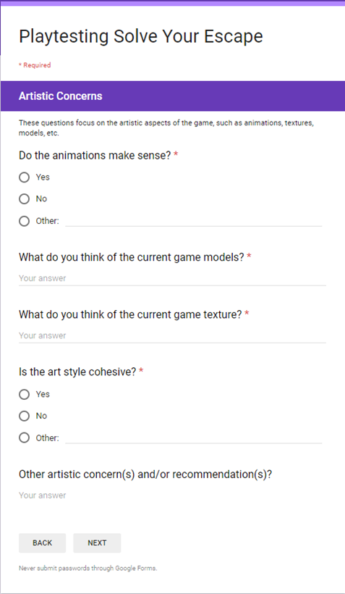
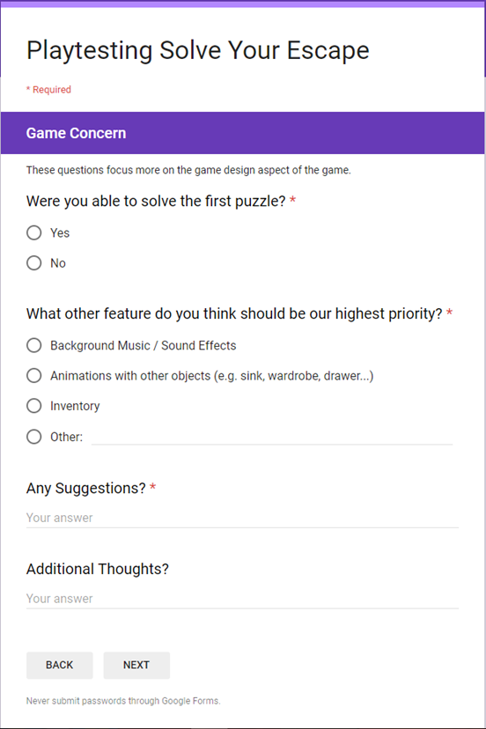
Playtesting Survey

Slide 12
Playtesting Results & Implementations
Issues that we are focusing for the Beta Version:
Fill in the missing textures for player and objects, as much as possible
Smooth the camera transition
Fix the interaction with other objects (such as book, bookshelf, etc.)
Add an endgame condition to complete the game loop
Several small fixes which are highlighted in the Beta Presentation
Issues that we identify, but decide to move on due to time constraint:
Fix the double-clicking bugs in the game
Add indicators for the gamepad
Expand puzzle mechanics / difficulty
Several additional models and textures for the expansion

Slide 13
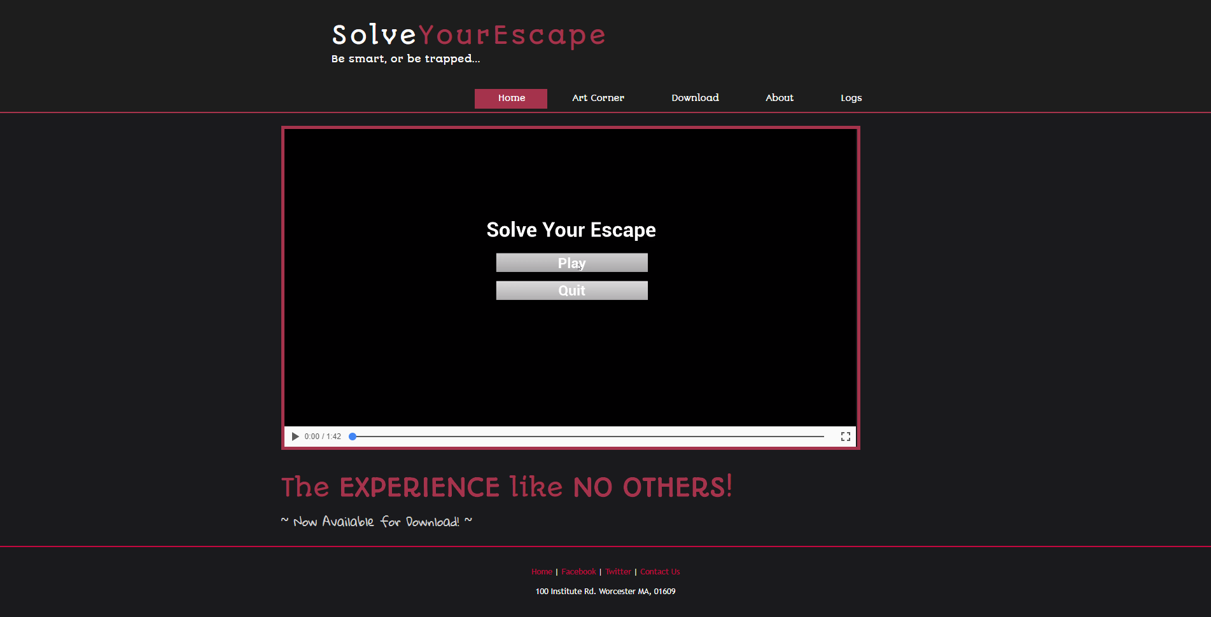
Website - Main Page

Slide 14
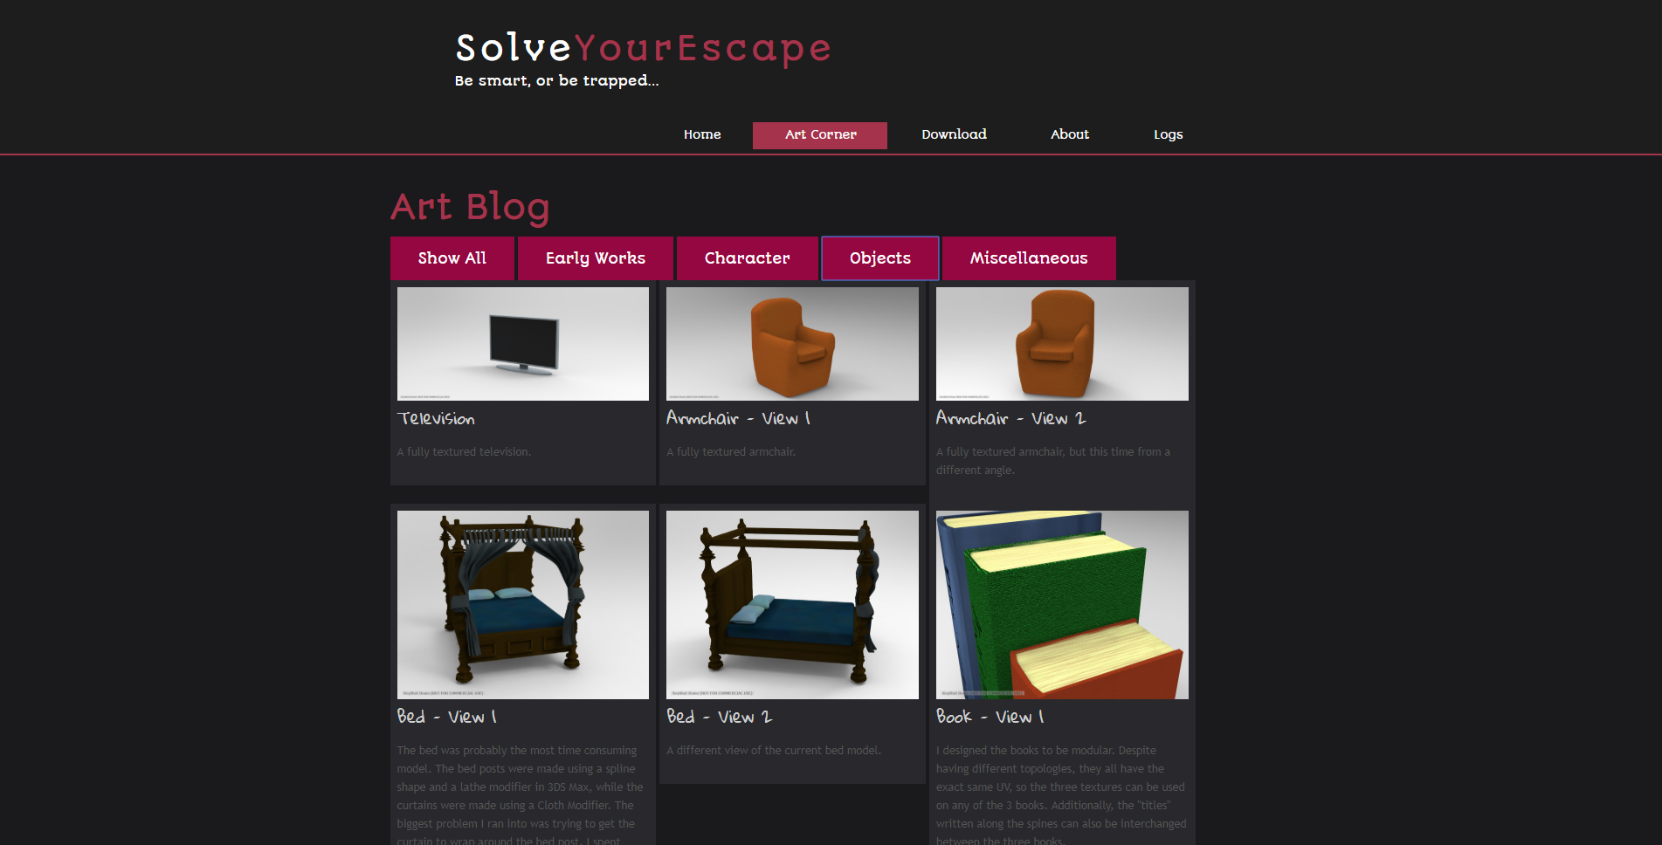
Website - Art Blog

Slide 15
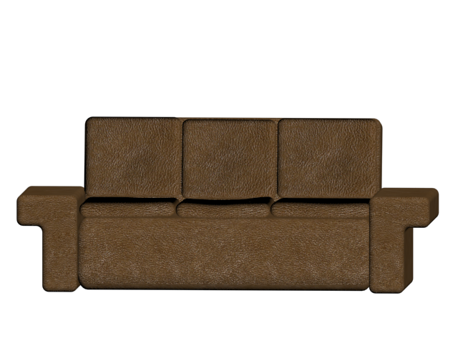
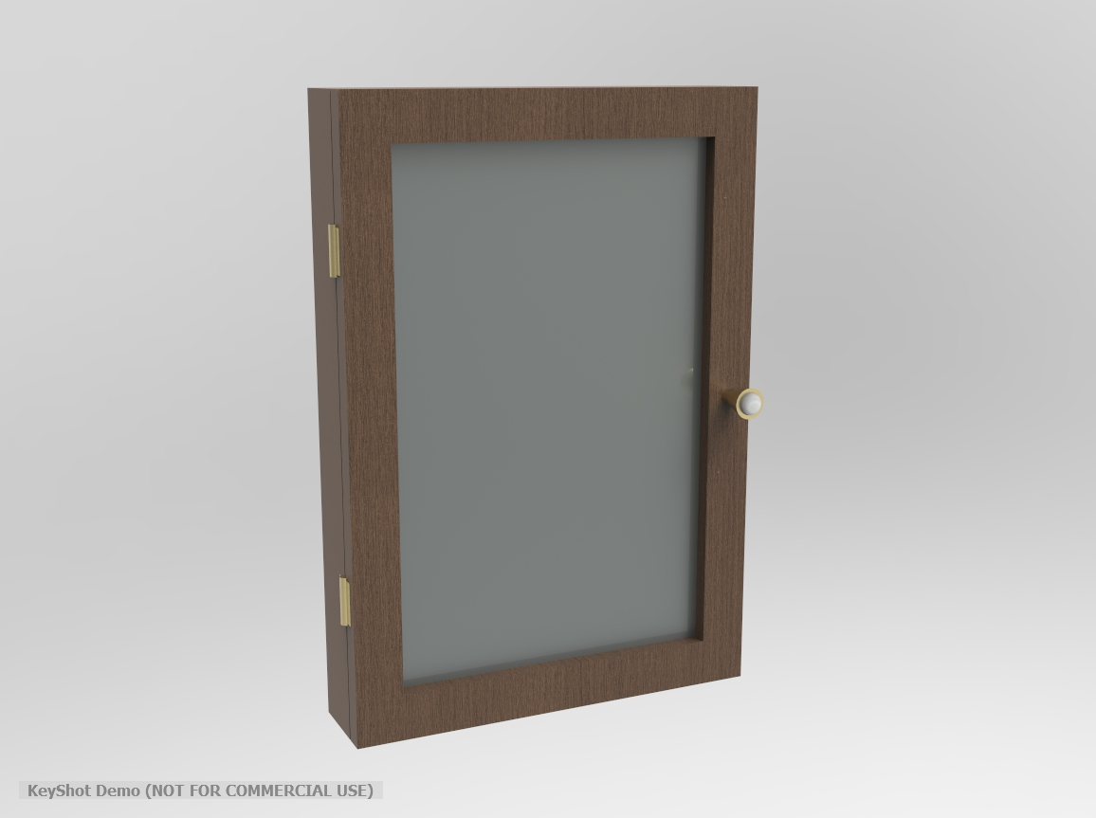

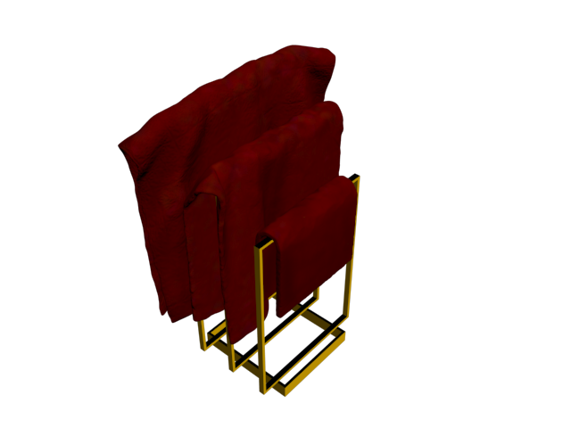
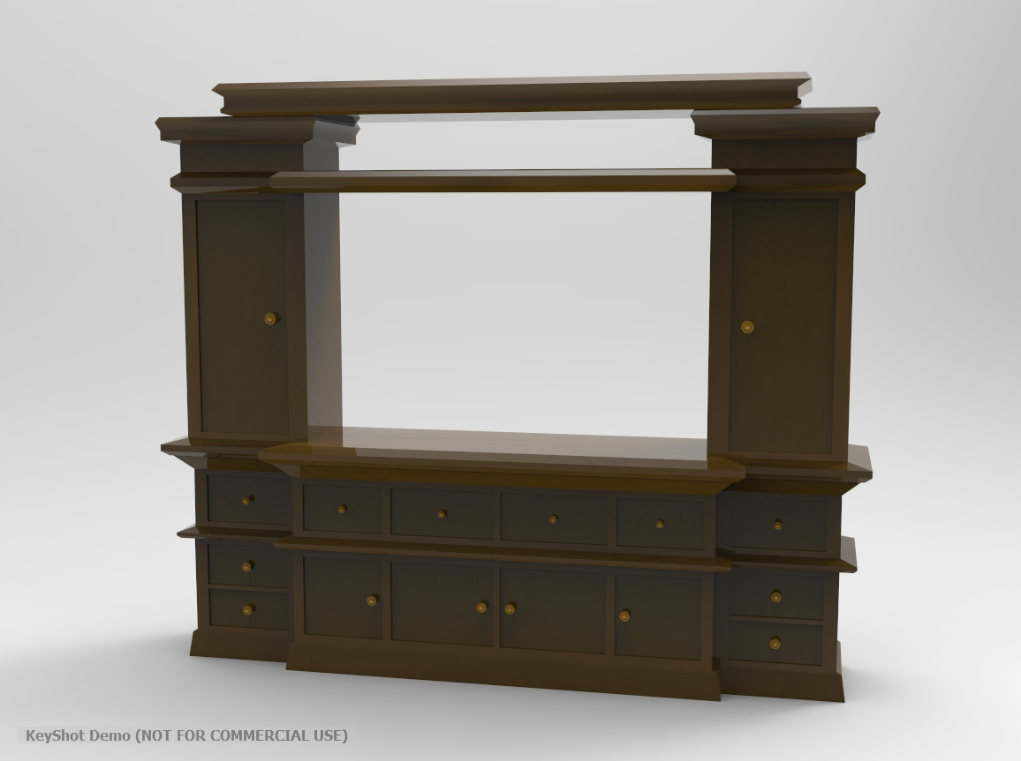
Art

Slide 16
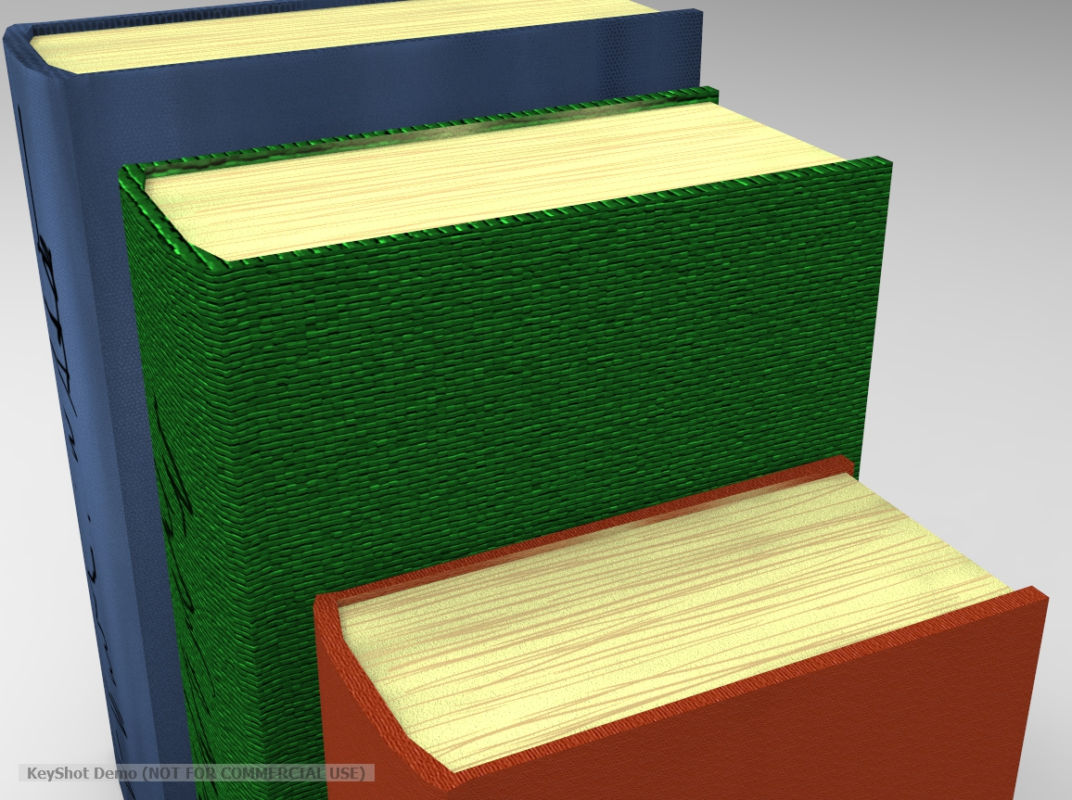
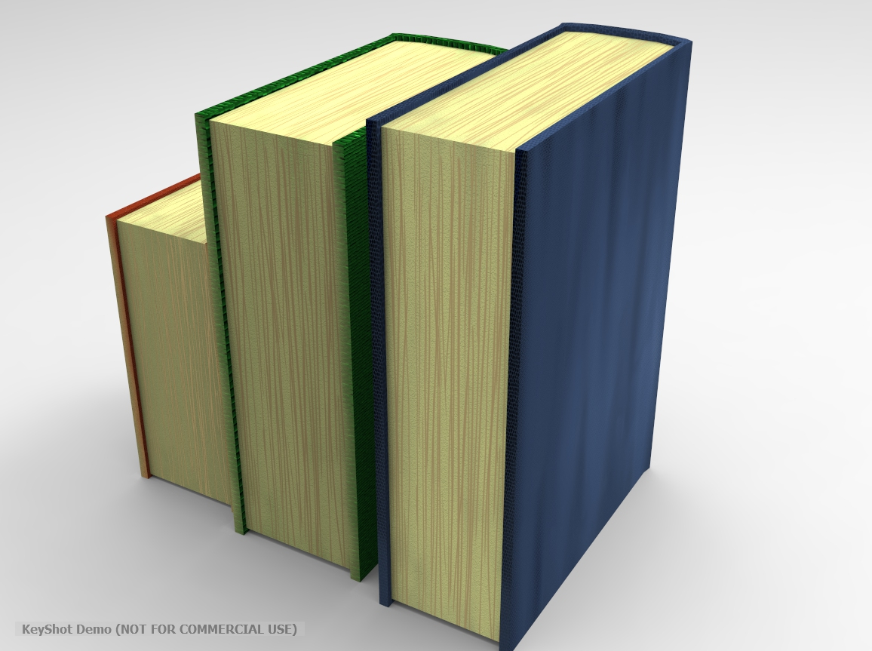
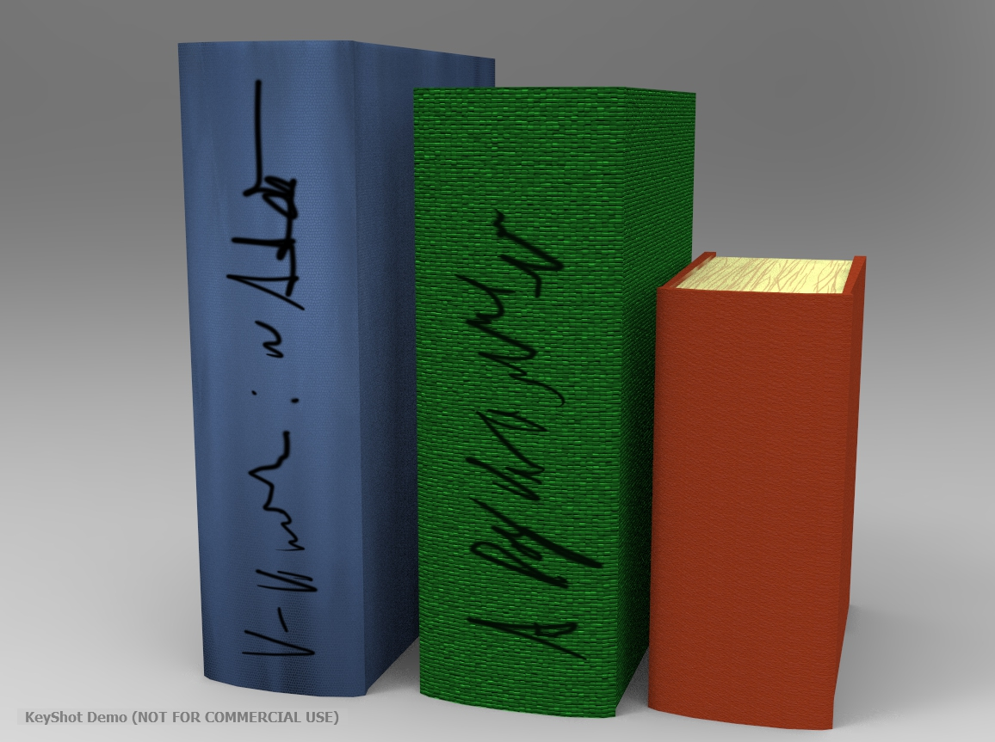
Art

Slide 17
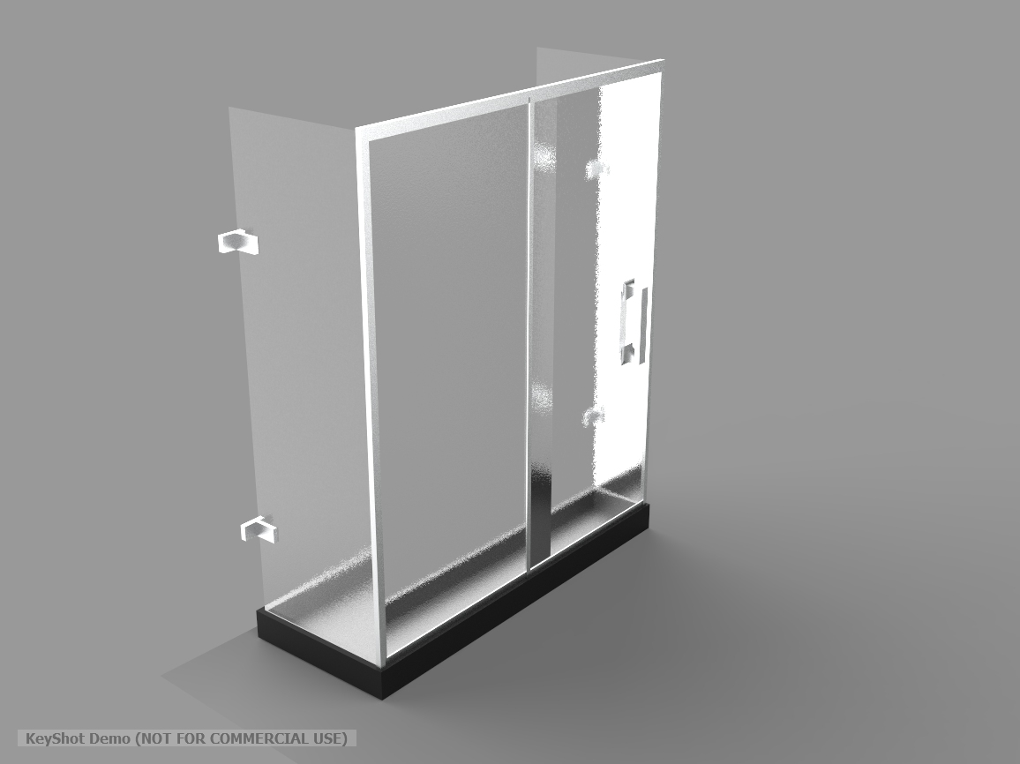
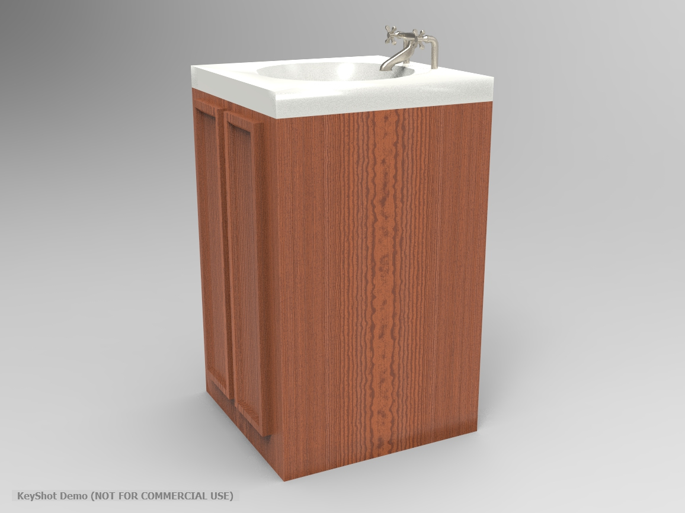
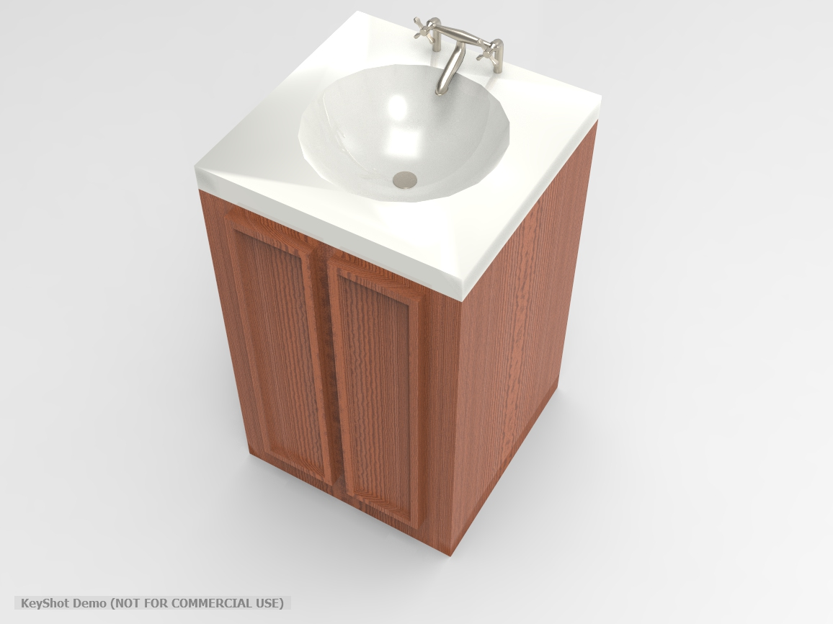
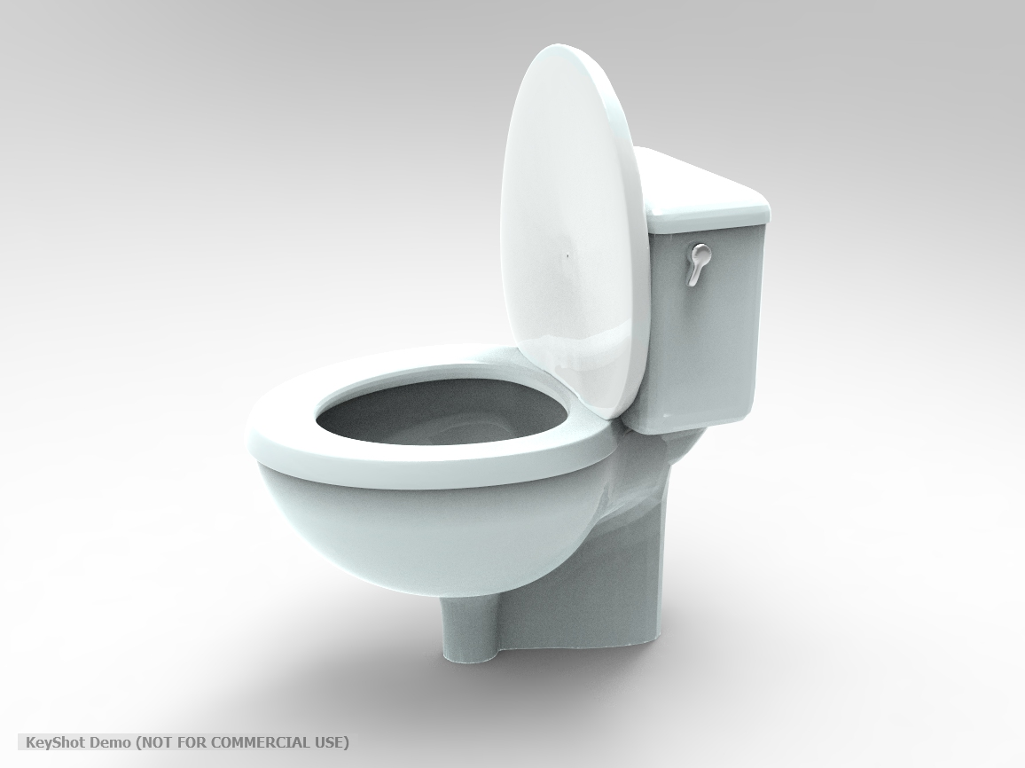
Art

Slide 18
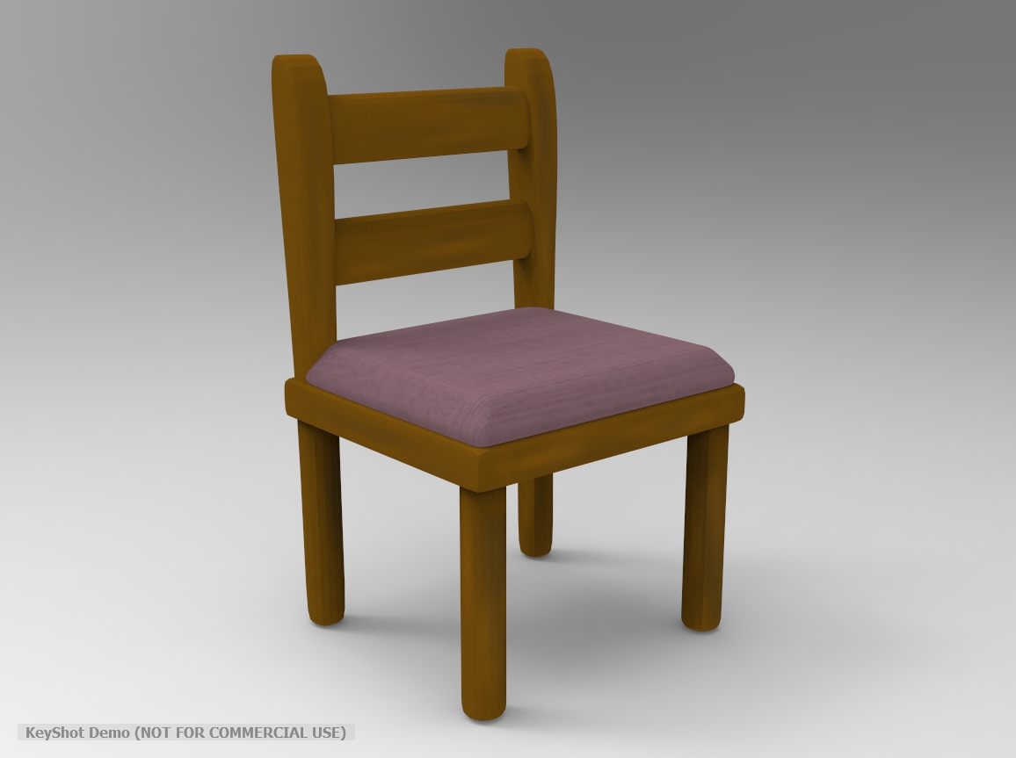
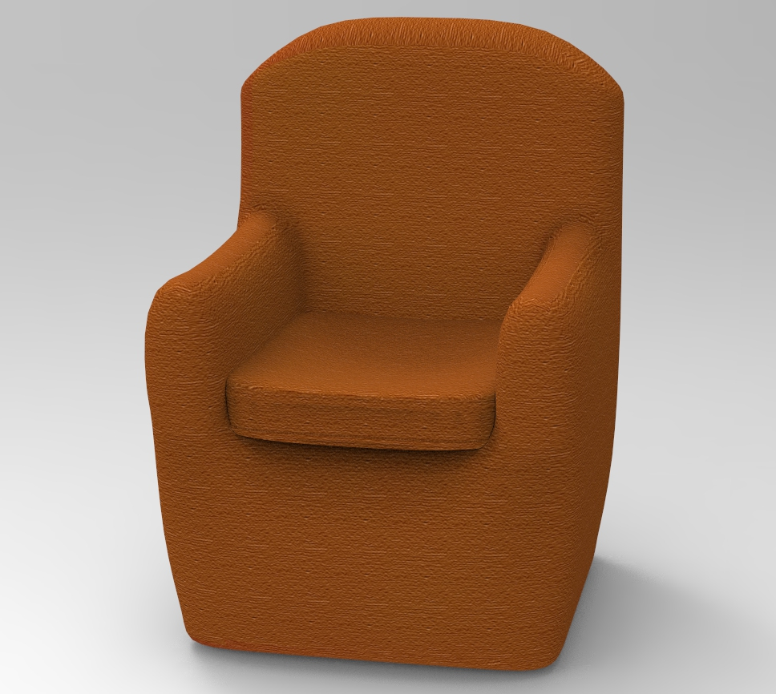
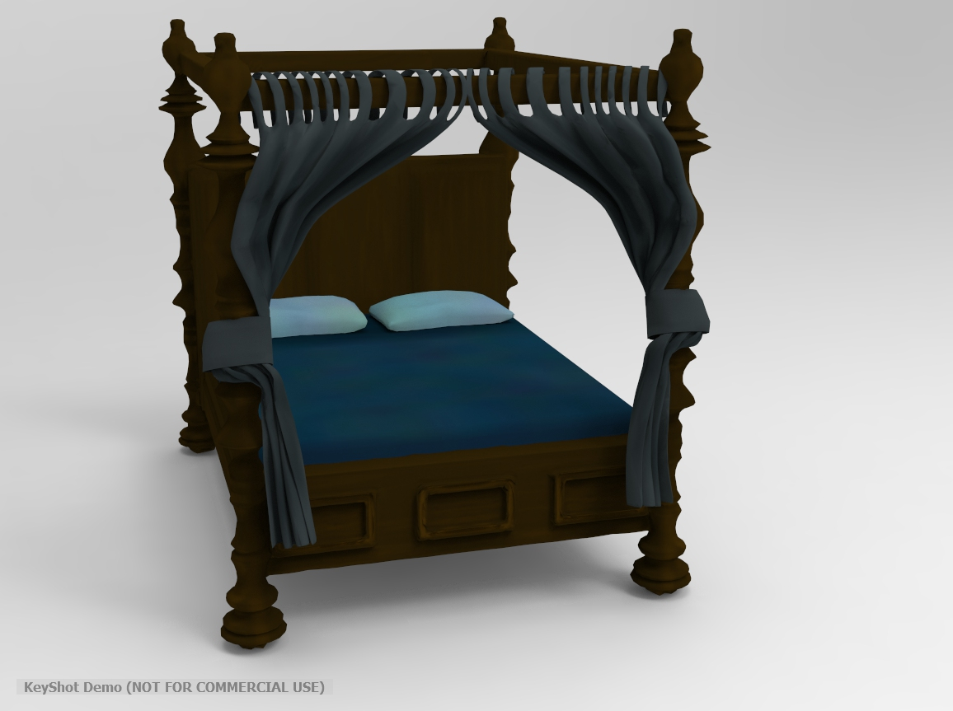
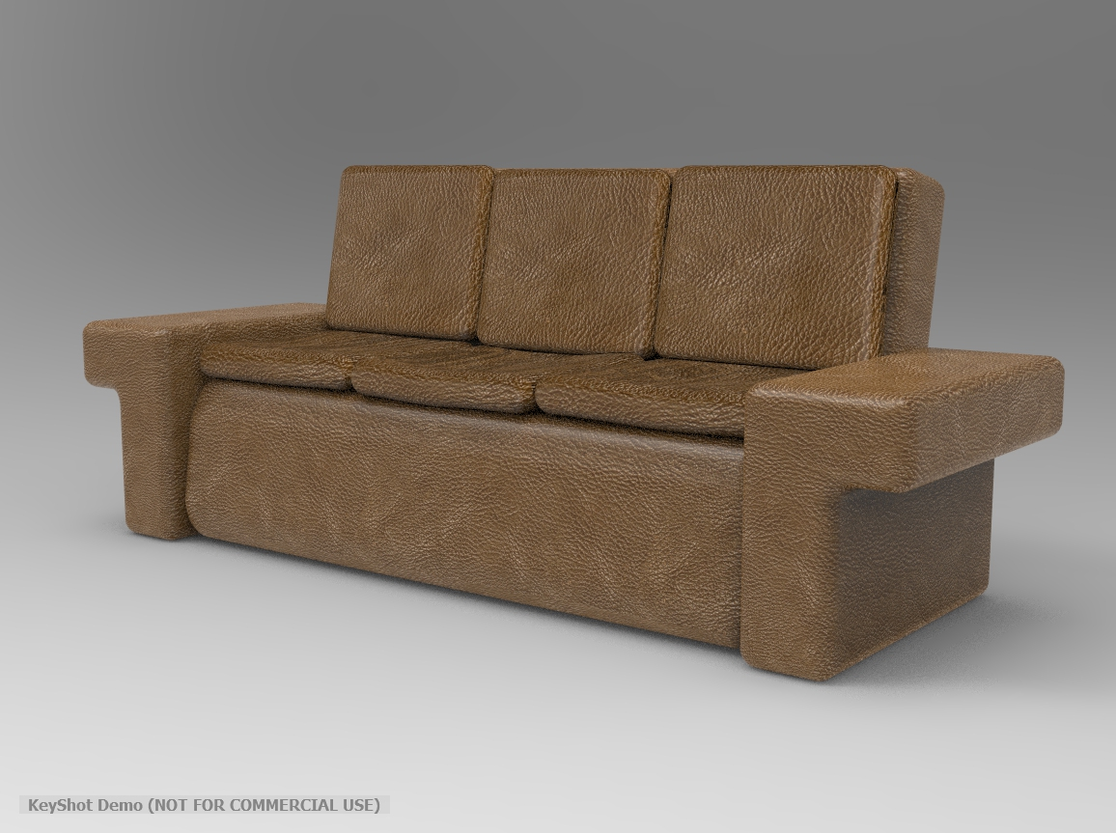
Art

Slide 19
Thank you
Any questions?

